Slide 1
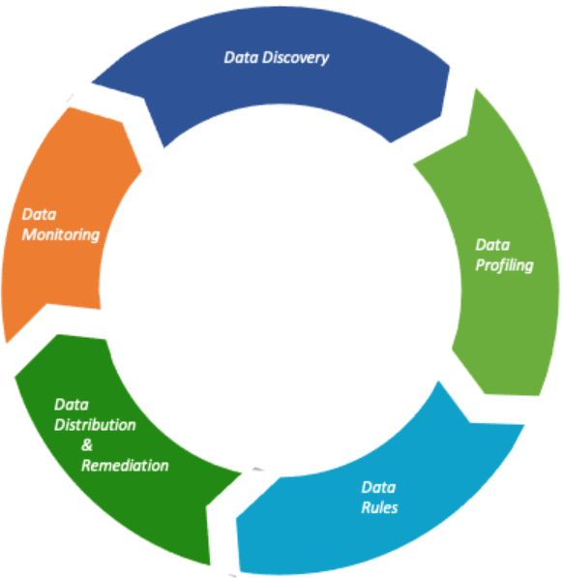
Data Quality Lifecycle
The Data Quality Lifecycle is a sequence of processes that data quality projects go through from initiation to its closure, and includes the following :

Slide 2





High Level Overview of Data Quality Framework
Send an Auto generated alert email with Data Quality Results
Raw/Final Layer of Data
external Rule based Config File
or
Data Quality Framework
Data Quality Test
Data Sources

Slide 3
A list of most common data quality metrics is given below, but we need to select the ones that are helpful in our case and figure out the least percentile values that represent good data quality. Accuracy: How well do data values depict reality/correctness? Lineage: How trustworthy is the originating source of data values? Semantic: Are data values true to their meaning? Structure: Do data values exist in the correct pattern and/or format? Completeness: Is your data as comprehensive as you need it to be? Consistency: Do disparate data stores have the same data values for the same records? Currency: Is your data acceptably up to date? Timeliness: How quickly is the requested data made available? Reasonableness: Do data values have the correct data type and size? Identifiability: Does every record represent a unique identity and is not a duplicate?

Slide 4
Sample Rule File :
[{
"entity_name": "db.table_1",
"rules": [
{
"rule_name": "isNonNegative",
"column": "col_2"
},
{
"rules_name": "satisfies",
"column": "col_name IS NULL OR col_name IN ('BUY','SELL')",
},
{
"rules_name": "hasSize",
"condition": ">= 100000"
}
]},
{ "entity_name": "db.table_2",
"rules": [
{
"name": "satisfies",
"column": "column_name IS NULL OR column_name IN('value')",
},
{
"name": "hasSize",
"condition": ">= 10000"
},
{
"name": "hasDistinctness",
"column": "coll"
}
]}]

Slide 5
Sample Data Quality Output
Seq | validation_rule | column_name | constraint_msg | result_status | total_rows | pass_count | fail_count | rule_name | input_data
1 | .isNonNegative("customer_id") | customer_id | ‘customer_id’ has no negative values | Success | 100 | 100 | 0 | Non Negetive | select * from database.table_1
2 | .isContainedIn("country", Array("US", "UK", "DE", "JP", "FR")) | country | ‘country’ has value range ‘US’, ‘UK’, ‘DE’, ‘JP’,'FR' | Failure | 100 | 40 | 60 | Contained In | select * from database.table_2

